Slide 1
Understanding a Modern Processing-in-Memory Architecture:
Benchmarking and Experimental Characterization
Juan Gómez Luna, Izzat El Hajj,
Ivan Fernandez, Christina Giannoula,
Geraldo F. Oliveira, Onur Mutlu
https://arxiv.org/pdf/2105.03814.pdf
https://github.com/CMU-SAFARI/prim-benchmarks

Slide 2
Executive Summary
Data movement between memory/storage units and compute units is a major contributor to execution time and energy consumption
Processing-in-Memory (PIM) is a paradigm that can tackle the data movement bottleneck
Though explored for +50 years, technology challenges prevented the successful materialization
UPMEM has designed and fabricated the first publicly-available real-world PIM architecture
DDR4 chips embedding in-order multithreaded DRAM Processing Units (DPUs)
Our work:
Introduction to UPMEM programming model and PIM architecture
Microbenchmark-based characterization of the DPU
Benchmarking and workload suitability study
Main contributions:
Comprehensive characterization and analysis of the first commercially-available PIM architecture
PrIM (Processing-In-Memory) benchmarks:
16 workloads that are memory-bound in conventional processor-centric systems
Strong and weak scaling characteristics
Comparison to state-of-the-art CPU and GPU
Takeaways:
Workload characteristics for PIM suitability
Programming recommendations
Suggestions and hints for hardware and architecture designers of future PIM systems
PrIM: (a) programming samples, (b) evaluation and comparison of current and future PIM systems

Slide 3
Data Movement in Computing Systems
Data movement dominates performance and is a major system energy bottleneck
Total system energy: data movement accounts for
62% in consumer applications✻,
40% in scientific applications★,
35% in mobile applications☆
Data Movement
SoC
DRAM
CPU
CPU
L2
GPU
Video Encoder
Video Decoder
Audio
Display Engine
✻ Boroumand et al., “Google Workloads for Consumer Devices: Mitigating Data Movement Bottlenecks,” ASPLOS 2018
★ Kestor et al., “Quantifying the Energy Cost of Data Movement in Scientific Applications,” IISWC 2013
☆ Pandiyan and Wu, “Quantifying the energy cost of data movement for emerging smart phone workloads on mobile platforms,” IISWC 2014

Slide 4
Data Movement in Computing Systems
Data movement dominates performance and is a major system energy bottleneck
Total system energy: data movement accounts for
62% in consumer applications✻,
40% in scientific applications★,
35% in mobile applications☆
Compute systems should be more data-centric
Data Movement
SoC
CPU
Processing-In-Memory proposes
computing where it makes sense
(where data resides)
CPU
L2
DRAM
GPU
Video Encoder
Video Decoder
Audio
Display Engine
✻ Boroumand et al., “Google Workloads for Consumer Devices: Mitigating Data Movement Bottlenecks,” ASPLOS 2018
★ Kestor et al., “Quantifying the Energy Cost of Data Movement in Scientific Applications,” IISWC 2013
☆ Pandiyan and Wu, “Quantifying the energy cost of data movement for emerging smart phone workloads on mobile platforms,” IISWC 2014

Slide 5
UPMEM Processing-in-DRAM Engine (2019)
Processing in DRAM Engine
Includes standard DIMM modules, with a large number of DPU processors combined with DRAM chips.
Replaces standard DIMMs
DDR4 R-DIMM modules
8GB+128 DPUs (16 PIM chips)
Standard 2x-nm DRAM process
Large amounts of compute & memory bandwidth
CPU
(x86, ARM, RV…)
DDR
Data bus
https://www.anandtech.com/show/14750/hot-chips-31-analysis-inmemory-processing-by-upmem
https://www.upmem.com/video-upmem-presenting-its-true-processing-in-memory-solution-hot-chips-2019/

Slide 6
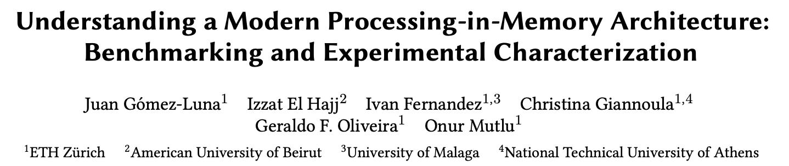
Understanding a Modern PIM Architecture
https://arxiv.org/pdf/2105.03814.pdf
https://github.com/CMU-SAFARI/prim-benchmarks

Slide 7
Observations, Recommendations, Takeaways
GENERAL PROGRAMMING RECOMMENDATIONS
Execute on the DRAM Processing Units (DPUs) portions of parallel code that are as long as possible.
Split the workload into independent data blocks, which the DPUs operate on independently.
Use as many working DPUs in the system as possible.
Launch at least 11 tasklets (i.e., software threads) per DPU.
PROGRAMMING RECOMMENDATION 1
For data movement between the DPU’s MRAM bank and the WRAM, use large DMA transfer sizes when all the accessed data is going to be used.
KEY OBSERVATION 7
Larger CPU-DPU and DPU-CPU transfers between the host main memory and the DRAM Processing Unit’s Main memory (MRAM) banks result in higher sustained bandwidth.
KEY TAKEAWAY 1
The UPMEM PIM architecture is fundamentally compute bound. As a result, the most suitable work- loads are memory-bound.

Slide 8
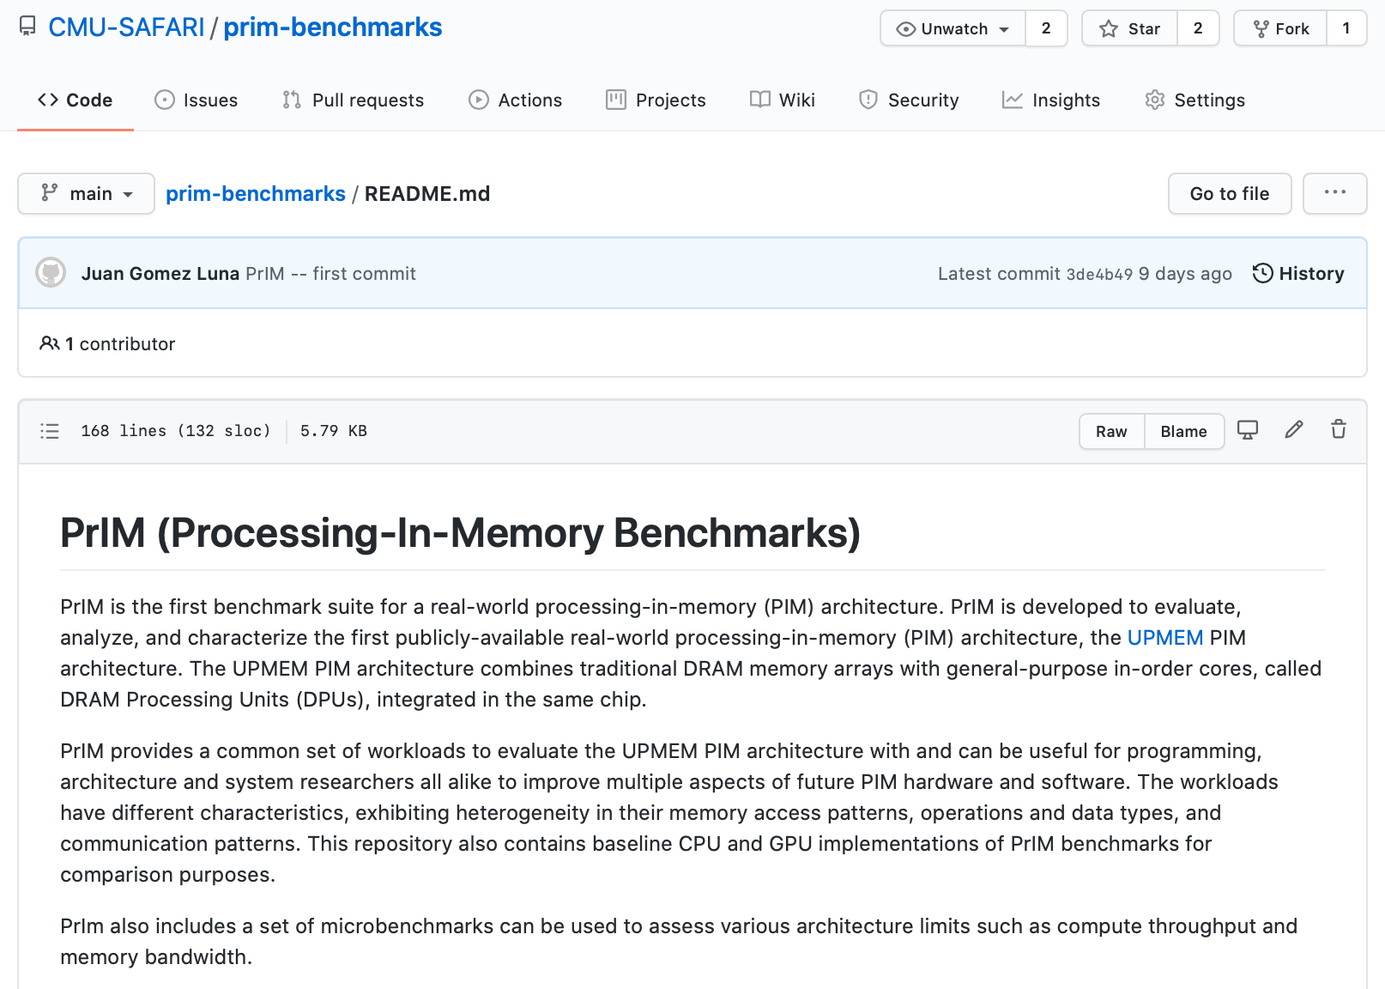
PrIM Repository
All microbenchmarks, benchmarks, and scripts
https://github.com/CMU-SAFARI/prim-benchmarks

Slide 9
Outline
Introduction
Accelerator Model
UPMEM-based PIM System Overview
UPMEM PIM Programming
Vector Addition
CPU-DPU Data Transfers
Inter-DPU Communication
CPU-DPU/DPU-CPU Transfer Bandwidth
DRAM Processing Unit
Arithmetic Throughput
WRAM and MRAM Bandwidth
PrIM Benchmarks
Roofline Model
Benchmark Diversity
Evaluation
Strong and Weak Scaling
Comparison to CPU and GPU
Key Takeaways

Slide 10
Outline
Introduction
Accelerator Model
UPMEM-based PIM System Overview
UPMEM PIM Programming
Vector Addition
CPU-DPU Data Transfers
Inter-DPU Communication
CPU-DPU/DPU-CPU Transfer Bandwidth
DRAM Processing Unit
Arithmetic Throughput
WRAM and MRAM Bandwidth
PrIM Benchmarks
Roofline Model
Benchmark Diversity
Evaluation
Strong and Weak Scaling
Comparison to CPU and GPU
Key Takeaways

Slide 11
Accelerator Model
UPMEM DIMMs coexist with conventional DIMMs
Integration of UPMEM DIMMs in a system follows an accelerator model
UPMEM DIMMs can be seen as a loosely coupled accelerator
Explicit data movement between the main processor (host CPU) and the accelerator (UPMEM)
Explicit kernel launch onto the UPMEM processors
This resembles GPU computing

Slide 12
System Organization (I)
In a UPMEM-based PIM system UPMEM DIMMs coexist with regular DDR4 DIMMs
Notes:
P21 DIMMs.
DPUs cannot be shared. There is a large number of DPUs.
No need for OS.
This simplifies security implications. No side channels.

Slide 13
System Organization (II)
A UPMEM DIMM contains 8 or 16 chips
Thus, 1 or 2 ranks of 8 chips each
Inside each PIM chip there are:
8 64MB banks per chip: Main RAM (MRAM) banks
8 DRAM Processing Units (DPUs) in each chip, 64 DPUs per rank

Slide 14
2,560-DPU System (I)
UPMEM-based PIM system with 20 UPMEM DIMMs of 16 chips each (40 ranks)
P21 DIMMs
Dual x86 socket
UPMEM DIMMs coexist with regular DDR4 DIMMs
2 memory controllers/socket (3 channels each)
2 conventional DDR4 DIMMs on one channel of one controller
2560 DPUs*
160 GB
* There are 4 faulty DPUs in the system that we use in our experiments. Thus, the maximum number of DPUs we can use is 2,556.

Slide 15
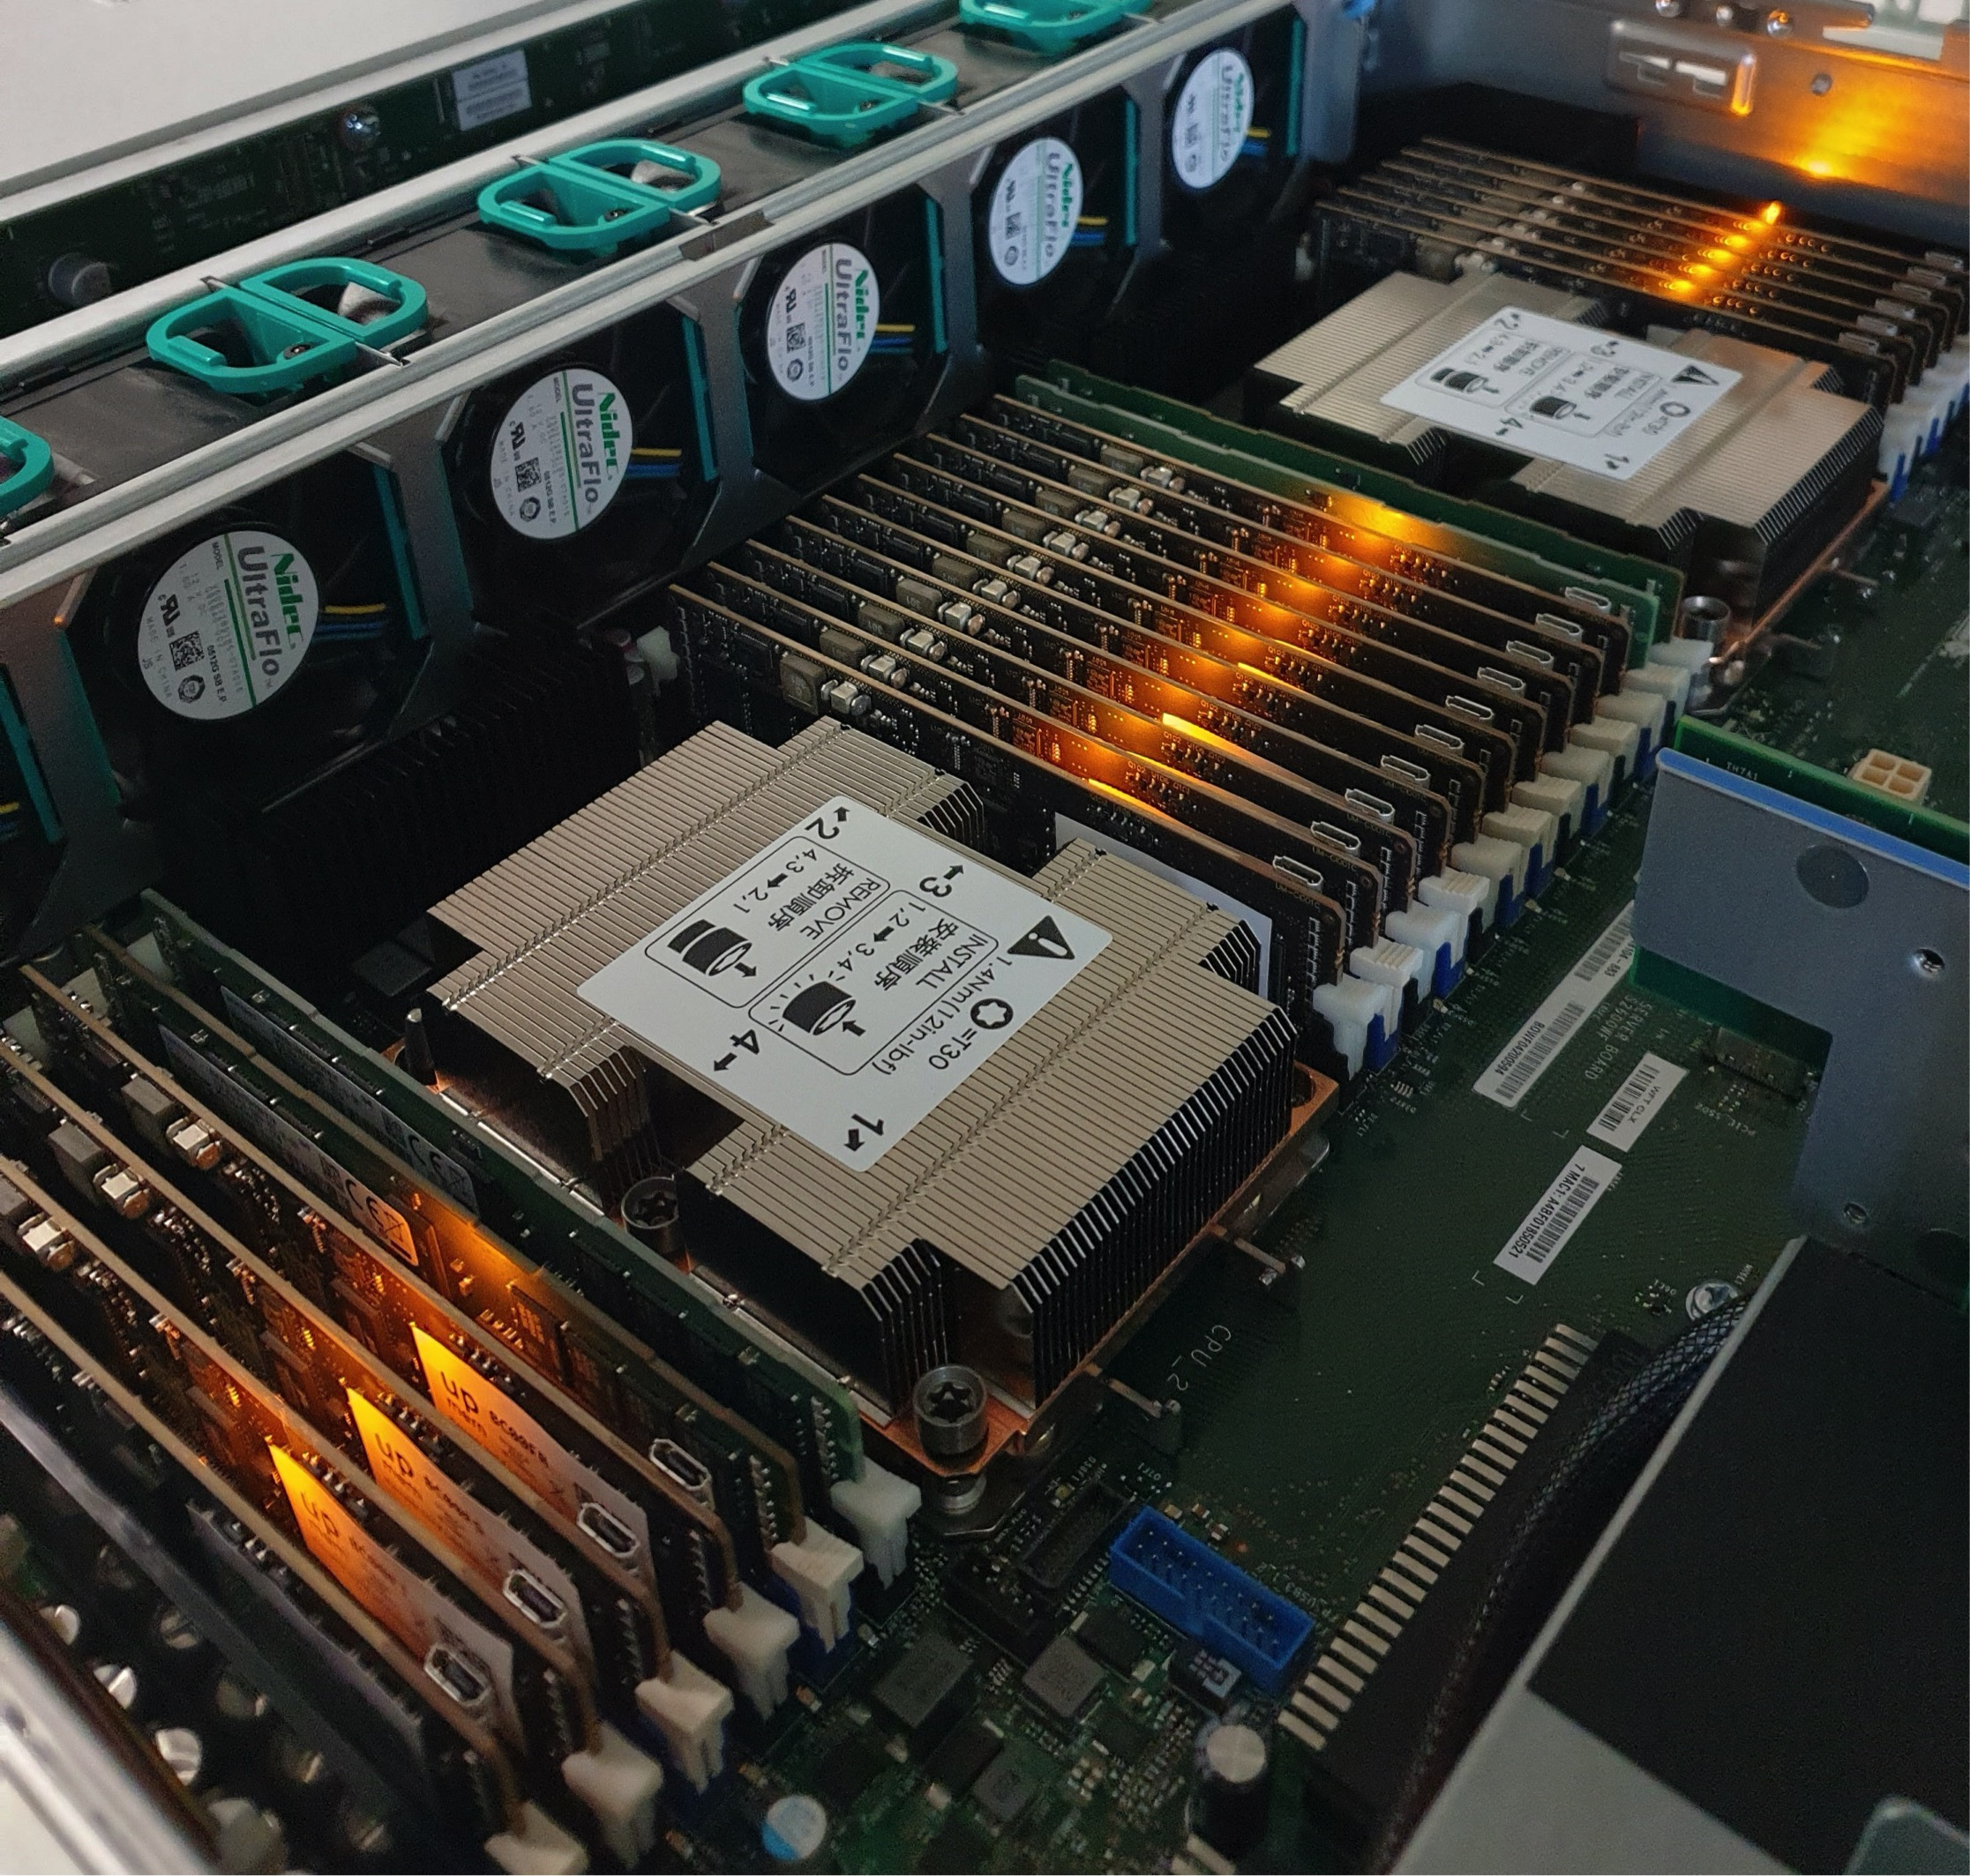
2,560-DPU System (II)

Slide 16
640-DPU System
UPMEM-based PIM system with 10 UPMEM DIMMs of 8 chips each (10 ranks)
E19 DIMMs
x86 socket
2 memory controllers (3 channels each)
2 conventional DDR4 DIMMs on one channel of one controller
640 DPUs
40 GB

Slide 17
Outline
Introduction
Accelerator Model
UPMEM-based PIM System Overview
UPMEM PIM Programming
Vector Addition
CPU-DPU Data Transfers
Inter-DPU Communication
CPU-DPU/DPU-CPU Transfer Bandwidth
DRAM Processing Unit
Arithmetic Throughput
WRAM and MRAM Bandwidth
PrIM Benchmarks
Roofline Model
Benchmark Diversity
Evaluation
Strong and Weak Scaling
Comparison to CPU and GPU
Key Takeaways

Slide 18
Vector Addition (VA)
Our first programming example
We partition the input arrays across:
DPUs
Tasklets, i.e., software threads running on a DPU
Tasklet 0
Tasklet 1
Tasklet 0
Tasklet 1
Tasklet 0
Tasklet 1
Tasklet 0
Tasklet 1
DPU 0
DPU 1
DPU 2
DPU 3

Slide 19
General Programming Recommendations
From UPMEM programming guide✻, presentations★, and white papers☆
GENERAL PROGRAMMING RECOMMENDATIONS
Execute on the DRAM Processing Units (DPUs) portions of parallel code that are as long as possible.
Split the workload into independent data blocks, which the DPUs operate on independently.
Use as many working DPUs in the system as possible.
Launch at least 11 tasklets (i.e., software threads) per DPU.
✻ https://sdk.upmem.com/2021.1.1/index.html
★ F. Devaux, "The true Processing In Memory accelerator," HotChips 2019. doi: 10.1109/HOTCHIPS.2019.8875680
☆ UPMEM, “Introduction to UPMEM PIM. Processing-in-memory (PIM) on DRAM Accelerator,” White paper

Slide 20
CPU-DPU/DPU-CPU Data Transfers
CPU-DPU and DPU-CPU transfers
Between host CPU’s main memory and DPUs’ MRAM banks
Serial CPU-DPU/DPU-CPU transfers:
A single DPU (i.e., 1 MRAM bank)
Parallel CPU-DPU/DPU-CPU transfers:
Multiple DPUs (i.e., many MRAM banks)
Broadcast CPU-DPU transfers:
Multiple DPUs with a single buffer

Slide 21
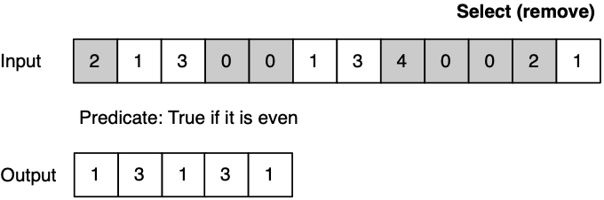
Different Types of Transfers in a Program
An example benchmark that uses both parallel and serial transfers
Select (SEL)
Remove even values
Parallel transfers
DPU 0
DPU 1
DPU 2
Serial transfers
DPU 0
DPU 1
DPU 2

Slide 22
Inter-DPU Communication
There is no direct communication channel between DPUs
Inter-DPU communication takes places via the host CPU using CPU-DPU and DPU-CPU transfers
Example communication patterns:
Merging of partial results to obtain the final result
Only DPU-CPU transfers
Redistribution of intermediate results for further computation
DPU-CPU transfers and CPU-DPU transfers

Slide 23
How Fast are these Data Transfers?
With a microbenchmark, we obtain the sustained bandwidth of all types of CPU-DPU and DPU-CPU transfers
Two experiments:
1 DPU: variable CPU-DPU and DPU-CPU transfer size (8 bytes to 32 MB)
1 rank: 32 MB CPU-DPU and DPU-CPU transfers to/from a set of 1 to 64 MRAM banks within the same rank
We do not experiment with more than one rank
Preliminary experiments show that the UPMEM SDK* only parallelizes transfers within the same rank
DDR4 bandwidth bounds the maximum transfer bandwidth
The cost of the transfers can be amortized,
if enough computation is run on the DPUs
* UPMEM SDK 2021.1.1

Slide 24
CPU-DPU/DPU-CPU Transfers: 1 DPU
Data transfer size varies between 8 bytes and 32 MB
KEY OBSERVATION 7
Larger CPU-DPU and DPU-CPU transfers between the host main memory and the DRAM Processing Unit’s Main memory (MRAM) banks result in higher sustained bandwidth.

Slide 25
CPU-DPU/DPU-CPU Transfers: 1 Rank
CPU-DPU (serial/parallel/broadcast) and DPU-CPU (serial/parallel)
The number of DPUs varies between 1 and 64
KEY OBSERVATION 8
The sustained bandwidth of parallel CPU-DPU and DPU-CPU transfers between the host main memory and the DRAM Processing Unit’s Main memory (MRAM) banks increases with the number of DRAM Processing Units inside a rank.

Slide 26
CPU-DPU/DPU-CPU Transfers: 1 Rank
CPU-DPU (serial/parallel/broadcast) and DPU-CPU (serial/parallel)
The number of DPUs varies between 1 and 64
KEY OBSERVATION 8
The sustained bandwidth of parallel CPU-DPU and DPU-CPU transfers between the host main memory and the DRAM Processing Unit’s Main memory (MRAM) banks increases with the number of DRAM Processing Units inside a rank.
https://arxiv.org/pdf/2105.03814.pdf
https://github.com/CMU-SAFARI/prim-benchmarks

Slide 27
Outline
Introduction
Accelerator Model
UPMEM-based PIM System Overview
UPMEM PIM Programming
Vector Addition
CPU-DPU Data Transfers
Inter-DPU Communication
CPU-DPU/DPU-CPU Transfer Bandwidth
DRAM Processing Unit
Arithmetic Throughput
WRAM and MRAM Bandwidth
PrIM Benchmarks
Roofline Model
Benchmark Diversity
Evaluation
Strong and Weak Scaling
Comparison to CPU and GPU
Key Takeaways

Slide 28
DRAM Processing Unit

Slide 29
DPU Pipeline
In-order pipeline
Up to 350 MHz
Fine-grain multithreaded
24 hardware threads
14 pipeline stages
DISPATCH: Thread selection
FETCH: Instruction fetch
READOP: Register file
FORMAT: Operand formatting
ALU: Operation and WRAM
MERGE: Result formatting
To the DMA engine

Slide 30
Arithmetic Throughput: Microbenchmark
Goal
Measure the maximum arithmetic throughput for different datatypes and operations
Microbenchmark
We stream over an array in WRAM and perform read-modify-write operations
Experiments on one DPU
We vary the number of tasklets from 1 to 24
Arithmetic operations: add, subtract, multiply, divide
Datatypes: int32, int64, float, double
We measure cycles with an accurate cycle counter that the SDK provides
We include WRAM accesses (including address calculation) and arithmetic operation

Slide 31
Microbenchmark for INT32 ADD Throughput
1 #define SIZE 256
2 int* bufferA = mem_alloc(SIZE * sizeof(int));
3 for(int i = 0; i < SIZE; i++){
4 int temp = bufferA[i];
5 temp += scalar;
6 bufferA[i] = temp;
7 }
1 move r2, 0
2 .LBB0_1: // Loop header
3 lsl_add r3, r0, r2, 2 // Address calculation
4 lw r4, r3, 0 // Load from WRAM
5 add r4, r4, r1 // Add
6 sw r3, 0, r4 // Store to WRAM
7 add r2, r2, 1 // Index update
8 jneq r2, 256, .LBB0_1 // Conditional jump
C-based code
Compiled code (UPMEM DPU ISA)

Slide 32
Arithmetic Throughput: 11 Tasklets
KEY OBSERVATION 1
The arithmetic throughput of a DRAM Processing Unit saturates at 11 or more tasklets.
This observation is consistent for different datatypes (INT32, INT64, UINT32, UINT64, FLOAT, DOUBLE) and operations (ADD, SUB, MUL, DIV).

Slide 33
Arithmetic Throughput: ADD/SUB
17%
INT32 ADD/SUB are 17% faster than INT64 ADD/SUB
Can we explain the peak throughput?
Peak throughput at 11 tasklets.
One instruction retires every cycle when the pipeline is full
$$Arithmetic Throughput \left(in OPS\right)=\frac{frequencyDPU}{\#instructions}$$

Slide 34
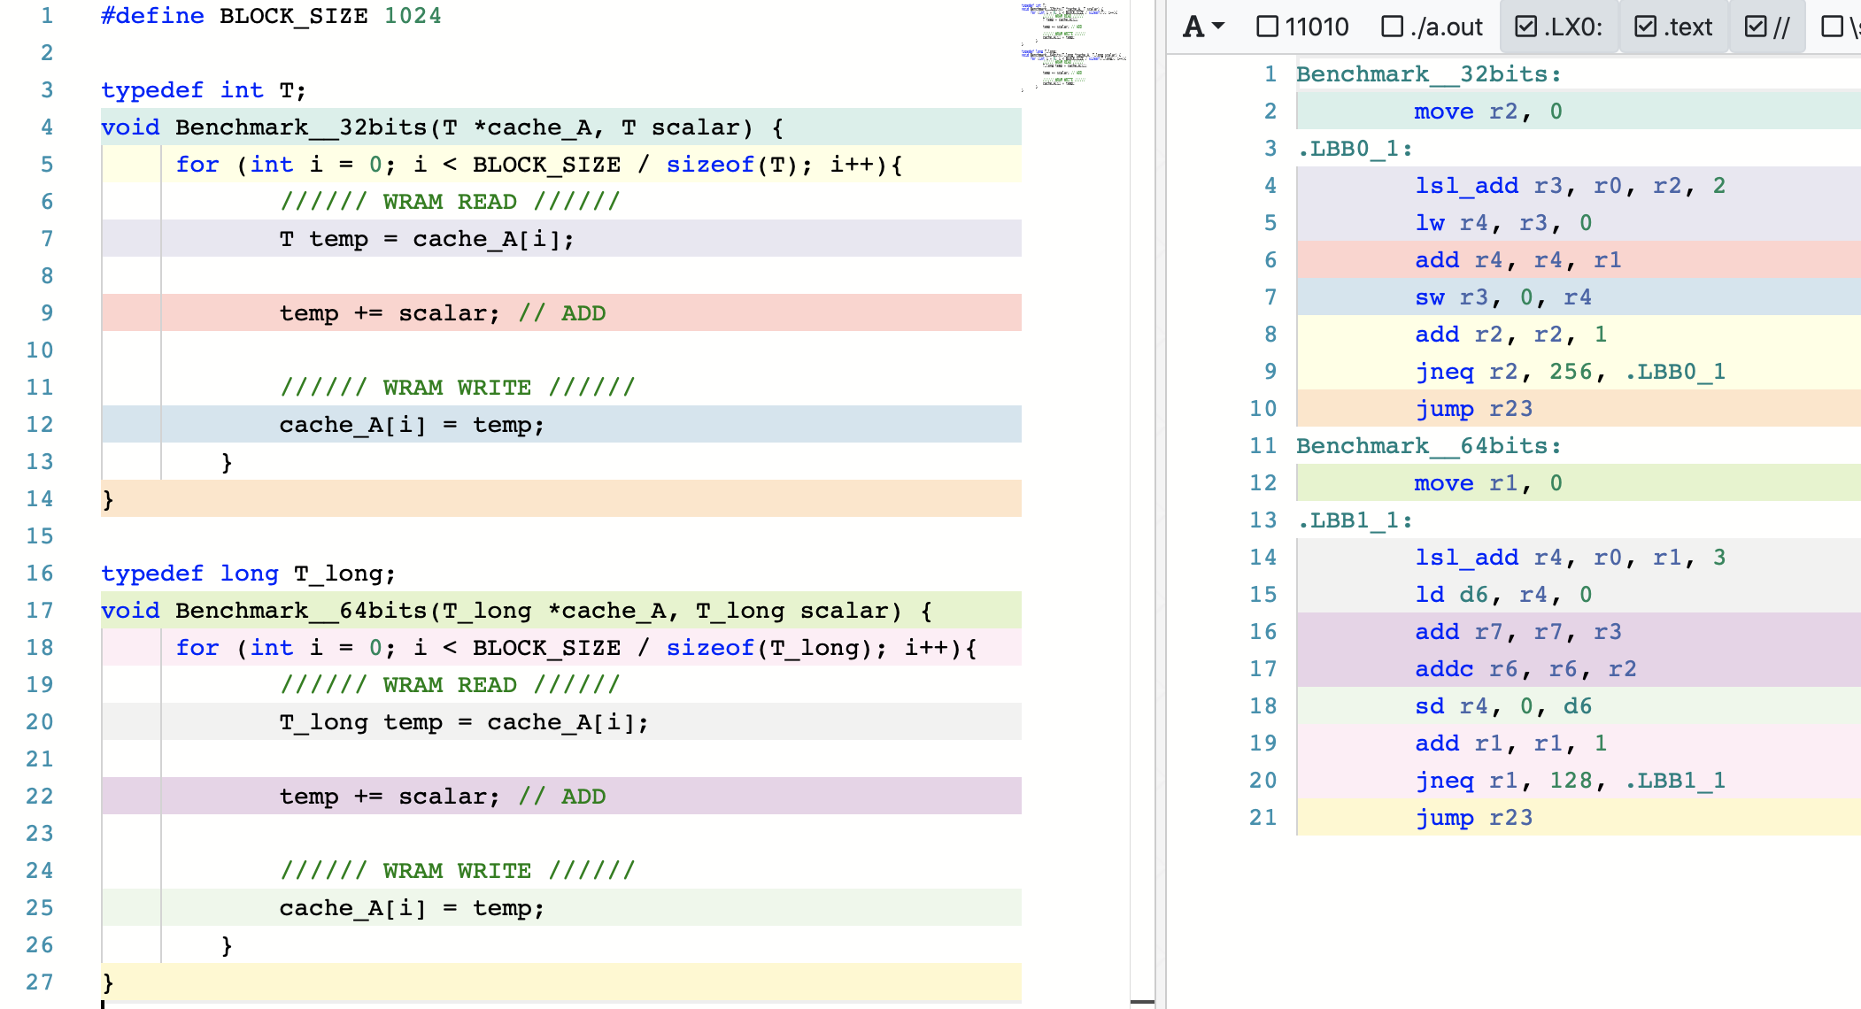
Arithmetic Throughput: #Instructions
Compiler explorer: https://dpu.dev
6 instructions in the 32-bit ADD/SUB microbenchmark
7 instructions in the 64-bit ADD/SUB microbenchmark

Slide 35
Arithmetic Throughput: ADD/SUB
17%
INT32 ADD/SUB are 17% faster than INT64 ADD/SUB
Can we explain the peak throughput?
Peak throughput at 11 tasklets.
One instruction retires every cycle when the pipeline is full
$$Arithmetic Throughput \left(in OPS\right)=\frac{frequencyDPU}{\#instructions}$$
32-bit ADD/SUB: 6 instructions → 58.33 MOPS
64-bit ADD/SUB: 7 instructions → 50.00 MOPS
at frequency_{DPU} = 350 MHz

Slide 36
Arithmetic Throughput: MUL/DIV
Huge throughput difference between ADD/SUB and MUL/DIV
DPUs do not have
a 32-bit multiplier
MUL/DIV implementation is based on an instruction that performs bit shifting and addition in 1 cycle
(MUL/DIV take a maximum of 32 instructions)

Slide 37
Arithmetic Throughput: Native Support
KEY OBSERVATION 2
DPUs provide native hardware support for 32- and 64-bit integer addition and subtraction, leading to high throughput for these operations.
DPUs do not natively support 32- and 64-bit multiplication and division, and floating point operations. These operations are emulated by the UPMEM runtime library, leading to much lower throughput.

Slide 38
DPU: WRAM Bandwidth

Slide 39
WRAM Bandwidth: Microbenchmark
Goal
Measure the WRAM bandwidth for the STREAM benchmark
Microbenchmark
We implement the four versions of STREAM: COPY, ADD, SCALE, and TRIAD
The operations performed in ADD, SCALE, and TRIAD are addition, multiplication, and addition+multiplication, respectively
We vary the number of tasklets from 1 to 16
We show results for 1 DPU
We do not include accesses to MRAM

Slide 40
STREAM Benchmark in WRAM
// COPY
for(int i = 0; i < SIZE; i++){
bufferB[i] = bufferA[i];
}
// ADD
for(int i = 0; i < SIZE; i++){
bufferC[i] = bufferA[i] + bufferB[i];
}
// SCALE
for(int i = 0; i < SIZE; i++){
bufferB[i] = scalar * bufferA[i];
}
// TRIAD
for(int i = 0; i < SIZE; i++){
bufferC[i] = bufferA[i] + scalar * bufferB[i];
}
8 bytes read, 8 bytes written,
no arithmetic operations
16 bytes read, 8 bytes written,
ADD
8 bytes read, 8 bytes written,
MUL
16 bytes read, 8 bytes written,
MUL, ADD

Slide 41

WRAM Bandwidth: STREAM
How can we estimate the bandwidth?
Assuming that the pipeline is full, and Bytes is the number of bytes read and written:
$$WRAM Bandwidth \left(in\frac{B}{S}\right)= \frac{Bytes × frequencyDPU}{\#instructions}$$

Slide 42

WRAM Bandwidth: COPY
COPY executes 2 instructions (WRAM load and store).
With 11 tasklets, 11 × 16 bytes in 22 cycles:
$$WRAM Bandwidth \left(in\frac{B}{S}\right)= \frac{Bytes × frequencyDPU}{\#instructions}$$
$$WRAM Bandwidth \left(in\frac{B}{S}\right)=2,800\frac{MB}{s}at 350 MHz$$

Slide 43
WRAM Bandwidth: Access Patterns
All 8-byte WRAM loads and stores take one cycle when the DPU pipeline is full
Microbenchmark: c[a[i]]=b[a[i]];
Unit-stride: a[i]=a[i-1]+1;
Strided: a[i]=a[i-1]+stride;
Random: a[i]=rand();
KEY OBSERVATION 3
The sustained bandwidth provided by the DPU’s internal Working memory (WRAM) is independent of the memory access pattern (either streaming, strided, or random access pattern).
All 8-byte WRAM loads and stores take one cycle, when the DPU’s pipeline is full (i.e., with 11 or more tasklets).
https://arxiv.org/pdf/2105.03814.pdf
https://github.com/CMU-SAFARI/prim-benchmarks

Slide 44
DPU: MRAM Latency and Bandwidth

Slide 45
MRAM Bandwidth
Goal
Measure MRAM bandwidth for different access patterns
Microbenchmarks
Latency of a single DMA transfer for different transfer sizes
mram_read(); // MRAM-WRAM DMA transfer
mram_write(); // WRAM-MRAM DMA transfer
STREAM benchmark
COPY, COPY-DMA
ADD, SCALE, TRIAD
Strided access pattern
Coarse-grain strided access
Fine-grain strided access
Random access pattern (GUPS)
We do include accesses to MRAM

Slide 46

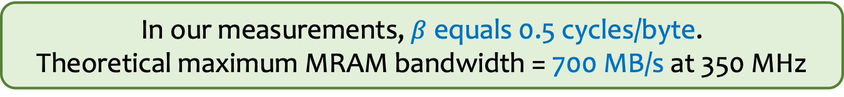
MRAM Read and Write Latency (I)
$$MRAM Bandwidth \left(in\frac{B}{S}\right)=\frac{size × frequencyDPU}{MRAM Latency}$$
We can model the MRAM latency with a linear expression
$$MRAM Latency \left(in cycles\right)=α+β×size$$
In our measurements, $β$ equals 0.5 cycles/byte.
Theoretical maximum MRAM bandwidth = 700 MB/s at 350 MHz

Slide 47
MRAM Read and Write Latency (II)
KEY OBSERVATION 4
The DPU’s Main memory (MRAM) bank access latency increases linearly with the transfer size.
The maximum theoretical MRAM bandwidth is 2 bytes per cycle.
$$MRAM Latency \left(in cycles\right)=α+β×size$$

Slide 48
MRAM Read and Write Latency (III)
Read and write accesses to MRAM are symmetric
The sustained MRAM bandwidth increases
with data transfer size
PROGRAMMING RECOMMENDATION 1
For data movement between the DPU’s MRAM bank and the WRAM, use large DMA transfer sizes when all the accessed data is going to be used.

Slide 49
MRAM Read and Write Latency (IV)
PROGRAMMING RECOMMENDATION 2
For small transfers between the MRAM bank and the WRAM, fetch more bytes than necessary within a 128-byte limit. Doing so increases the likelihood of finding data in WRAM for later accesses (i.e., the program can check whether the desired data is in WRAM before issuing a new MRAM access).
PROGRAMMING RECOMMENDATION 3
Choose the data transfer size between the MRAM bank and the WRAM based on the program’s WRAM usage, as it imposes a tradeoff between the sustained MRAM bandwidth and the number of tasklets that can run in the DPU (which is dictated by the limited WRAM capacity).
https://arxiv.org/pdf/2105.03814.pdf
https://github.com/CMU-SAFARI/prim-benchmarks

Slide 50
MRAM Bandwidth
Goal
Measure MRAM bandwidth for different access patterns
Microbenchmarks
Latency of a single DMA transfer for different transfer sizes
mram_read(); // MRAM-WRAM DMA transfer
mram_write(); // WRAM-MRAM DMA transfer
STREAM benchmark
COPY, COPY-DMA
ADD, SCALE, TRIAD
Strided access pattern
Coarse-grain strided access
Fine-grain strided access
Random access pattern (GUPS)
We do include accesses to MRAM

Slide 51
STREAM Benchmark in MRAM
// COPY
// Load current MRAM block to WRAM
mram_read((__mram_ptr void const*)mram_address_A, bufferA,
SIZE * sizeof(uint64_t));
for(int i = 0; i < SIZE; i++){
bufferB[i] = bufferA[i];
}
// Write WRAM block to MRAM
mram_write(bufferB, (__mram_ptr void*)mram_address_B,
SIZE * sizeof(uint64_t));
// COPY-DMA
// Load current MRAM block to WRAM
mram_read((__mram_ptr void const*)mram_address_A, bufferA,
SIZE * sizeof(uint64_t));
// Write WRAM block to MRAM
mram_write(bufferB, (__mram_ptr void*)mram_address_B,
SIZE * sizeof(uint64_t));

Slide 52
STREAM Benchmark: COPY-DMA
The sustained bandwidth of COPY-DMA is close to
the theoretical maximum (700 MB/s): ~1.6 TB/s for 2,556 DPUs
COPY-DMA saturates with two tasklets, even though
the DMA engine can perform only one transfer at a time
Using two or more tasklets guarantees that there is always
a DMA request enqueued to keep the DMA engine busy

Slide 53
STREAM Benchmark: Bandwidth Saturation (I)
COPY and ADD saturate at 4 and 6 tasklets, respectively
SCALE and TRIAD saturate at 11 tasklets
The latency of MRAM accesses becomes longer than the pipeline latency after 4 and 6 tasklets for COPY and ADD, respectively
The pipeline latency of SCALE and TRIAD is longer than the MRAM latency for any number of tasklets (both use costly MUL)

Slide 54
STREAM Benchmark: Bandwidth Saturation (II)
KEY OBSERVATION 5
When the access latency to an MRAM bank for a streaming benchmark (COPY-DMA, COPY, ADD) is larger than the pipeline latency (i.e., execution latency of arithmetic operations and WRAM accesses), the performance of the DPU saturates at a number of tasklets smaller than 11. This is a memory-bound workload.
When the pipeline latency for a streaming benchmark (SCALE, TRIAD) is larger than the MRAM access latency, the performance of a DPU saturates at 11 tasklets. This is a compute-bound workload.

Slide 55
MRAM Bandwidth
Goal
Measure MRAM bandwidth for different access patterns
Microbenchmarks
Latency of a single DMA transfer for different transfer sizes
mram_read(); // MRAM-WRAM DMA transfer
mram_write(); // WRAM-MRAM DMA transfer
STREAM benchmark
COPY, COPY-DMA
ADD, SCALE, TRIAD
Strided access pattern
Coarse-grain strided access
Fine-grain strided access
Random access pattern (GUPS)
We do include accesses to MRAM

Slide 56
Strided and Random Access to MRAM
// COARSE-GRAINED STRIDED ACCESS
// Load current MRAM block to WRAM
mram_read((__mram_ptr void const*)mram_address_A, bufferA,
SIZE * sizeof(uint64_t));
mram_read((__mram_ptr void const*)mram_address_B, bufferB,
SIZE * sizeof(uint64_t));
for(int i = 0; i < SIZE; i += stride){
bufferB[i] = bufferA[i];
}
// Write WRAM block to MRAM
mram_write(bufferB, (__mram_ptr void*)mram_address_B,
SIZE * sizeof(uint64_t));
// FINE-GRAINED STRIDED & RANDOM ACCESS
for(int i = 0; i < SIZE; i += stride){
int index = i * sizeof(uint64_t);
// Load current MRAM element to WRAM
mram_read((__mram_ptr void const*)(mram_address_A + index), bufferA, sizeof(uint64_t));
// Write WRAM element to MRAM
mram_write(bufferA, (__mram_ptr void*)(mram_address_B + index), sizeof(uint64_t));
}
Notes:
For random accesses we implement the GUPS benchmark.

Slide 57
Strided and Random Accesses (I)
Large difference in maximum sustained bandwidth between coarse-grained and fine-grained DMA
Coarse-grained DMA uses 1,024-byte transfers,
while fine-grained DMA uses 8-byte transfers
Random access achieves very similar maximum sustained bandwidth to fine-grained strided approach

Slide 58
Strided and Random Accesses (II)
The sustained MRAM bandwidth of coarse-grained DMA decreases as the stride increases
The effective utilization of the transferred data decreases
as the stride becomes larger (e.g., a stride 4 means that only one fourth of the transferred data is used)

Slide 59
Strided and Random Accesses (III)
For a stride of 16 or larger, the fine-grained DMA approach achieves higher bandwidth
With stride 16, only one sixteenth of the maximum sustained bandwidth (622.36 MB/s) of coarse-grained DMA
is effectively used, which is lower than
the bandwidth of fine-grained DMA (72.58 MB/s)

Slide 60
Strided and Random Accesses (IV)
PROGRAMMING RECOMMENDATION 4
For strided access patterns with a stride smaller than 16 8-byte elements, fetch a large contiguous chunk (e.g., 1,024 bytes) from a DPU’s MRAM bank.
For strided access patterns with larger strides and random access patterns, fetch only the data elements that are needed from an MRAM bank.

Slide 61
DPU: Arithmetic Throughput vs. Operational Intensity

Slide 62
Arithmetic Throughput vs. Operational Intensity (I)
Goal
Characterize memory-bound regions and compute-bound regions for different datatypes and operations
Microbenchmark
We load one chunk of an MRAM array into WRAM
Perform a variable number of operations on the data
Write back to MRAM
The experiment is inspired by the Roofline model*
We define operational intensity (OI) as the number of arithmetic operations performed per byte accessed from MRAM (OP/B)
The pipeline latency changes with the operational intensity, but the MRAM access latency is fixed
*S. Williams et al., “Roofline: An Insightful Visual Performance Model for Multi-core Architectures,” CACM, 2009

Slide 63
Arithmetic Throughput vs. Operational Intensity (II)
int repetitions = input_repeat >= 1.0 ? (int)input_repeat : 1;
int stride = input_repeat >= 1.0 ? 1 : (int)(1 / input_repeat);
// Load current MRAM block to WRAM
mram_read((__mram_ptr void const*)mram_address_A, bufferA, SIZE * sizeof(T));
// Update
for(int r = 0; r < repetitions; r++){
for(int i = 0; i < SIZE; i+=stride){
#ifdef ADD
bufferA[i] += scalar; // ADD
#elif SUB
bufferA[i] -= scalar; // SUB
#elif MUL
bufferA[i] *= scalar; // MUL
#elif DIV
bufferA[i] /= scalar; // DIV
#endif
}
}
// Write WRAM block to MRAM
mram_write(bufferA, (__mram_ptr void*)mram_address_B, SIZE * sizeof(T));
input_repeat greater or equal to 1 indicates the (integer) number of repetitions per input element
input_repeat smaller than 1 indicates the fraction of elements that are updated

Slide 64
Arithmetic Throughput vs. Operational Intensity (III)
We show results of arithmetic throughput vs. operational intensity for
(a) 32-bit integer ADD, (b) 32-bit integer MUL,
(c) 32-bit floating-point ADD, and (d) 32-bit floating-point MUL
(results for other datatypes and operations show similar trends)

Slide 65
Arithmetic Throughput vs. Operational Intensity (IV)
In the memory-bound region, the arithmetic throughput increases with the operational intensity
Memory-bound region
Compute-bound region
In the compute-bound region, the arithmetic throughput is flat at its maximum
The throughput saturation point is the operational intensity
where the transition between
the memory-bound region and the compute-bound region happens
The throughput saturation point is as low as ¼ OP/B,
i.e., 1 integer addition per every 32-bit element fetched

Slide 66
Arithmetic Throughput vs. Operational Intensity (V)
KEY OBSERVATION 6
The arithmetic throughput of a DRAM Processing Unit (DPU) saturates at low or very low operational intensity (e.g., 1 integer addition per 32-bit element). Thus, the DPU is fundamentally a compute-bound processor.
We expect most real-world workloads be compute-bound in the UPMEM PIM architecture.

Slide 67
Outline
Introduction
Accelerator Model
UPMEM-based PIM System Overview
UPMEM PIM Programming
Vector Addition
CPU-DPU Data Transfers
Inter-DPU Communication
CPU-DPU/DPU-CPU Transfer Bandwidth
DRAM Processing Unit
Arithmetic Throughput
WRAM and MRAM Bandwidth
PrIM Benchmarks
Roofline Model
Benchmark Diversity
Evaluation
Strong and Weak Scaling
Comparison to CPU and GPU
Key Takeaways

Slide 68
PrIM Benchmarks
Goal
A common set of workloads that can be used to
evaluate the UPMEM PIM architecture,
compare software improvements and compilers,
compare future PIM architectures and hardware
Two key selection criteria:
Selected workloads from different application domains
Memory-bound workloads on processor-centric architectures
14 different workloads, 16 different benchmarks*
*There are two versions for two of the workloads (HST, SCAN).

Slide 69
PrIM Benchmarks: Application Domains
Domain | Benchmark | Short name
Dense linear algebra | Vector Addition | VA
 | Matrix-Vector Multiply | GEMV
Sparse linear algebra | Sparse Matrix-Vector Multiply | SpMV
Databases | Select | SEL
 | Unique | UNI
Data analytics | Binary Search | BS
 | Time Series Analysis | TS
Graph processing | Breadth-First Search | BFS
Neural networks | Multilayer Perceptron | MLP
Bioinformatics | Needleman-Wunsch | NW
Image processing | Image histogram (short) | HST-S
 | Image histogram (large) | HST-L
Parallel primitives | Reduction | RED
 | Prefix sum (scan-scan-add) | SCAN-SSA
 | Prefix sum (reduce-scan-scan) | SCAN-RSS
 | Matrix transposition | TRNS

Slide 70
Roofline Model
Intel Advisor on an Intel Xeon E3-1225 v6 CPU
Peak compute performance
L3
DRAM
All workloads fall in the memory-bound area of the Roofline

Slide 71
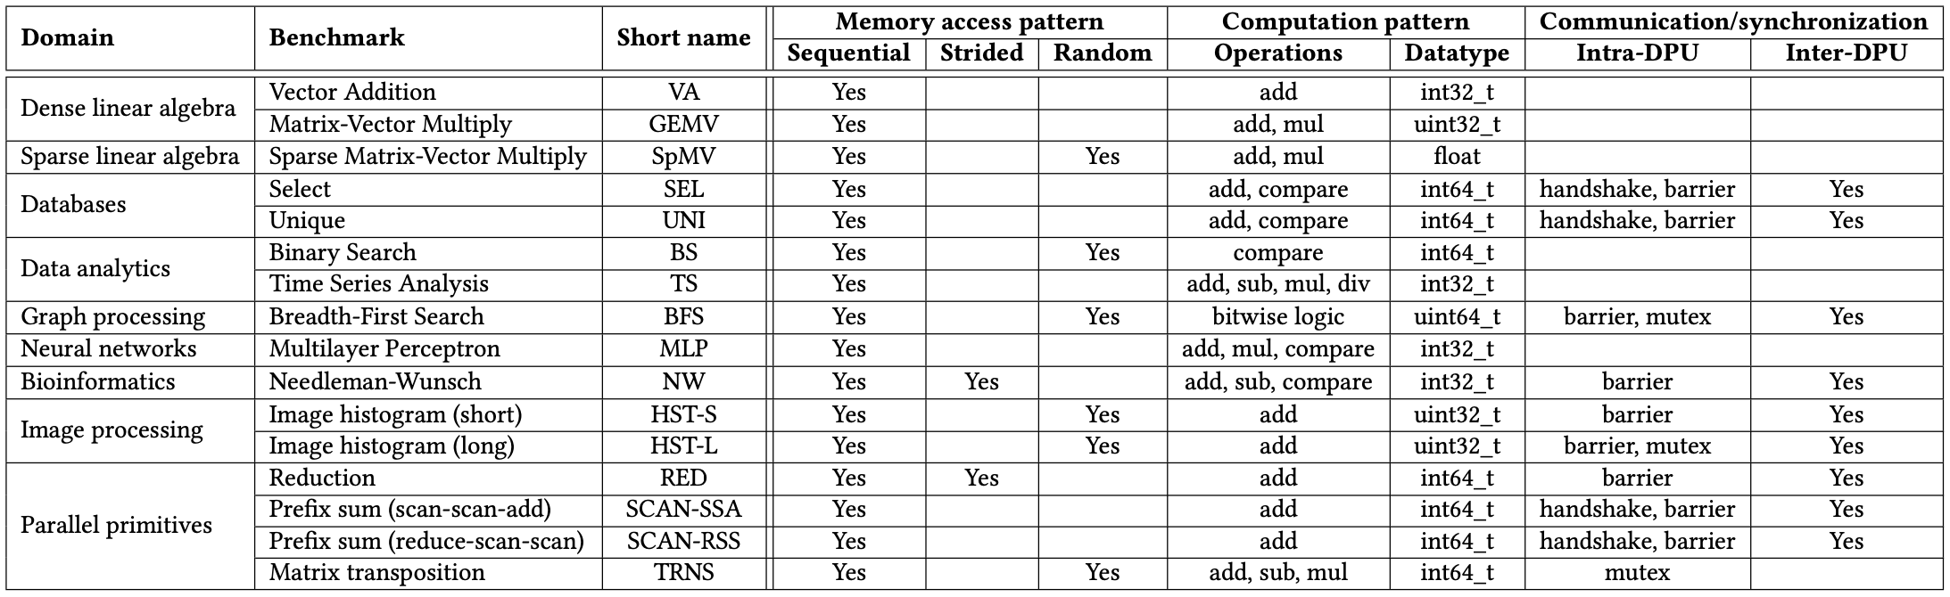
PrIM Benchmarks: Diversity
PrIM benchmarks are diverse:
Memory access patterns
Operations and datatypes
Communication/synchronization

Slide 72
PrIM Benchmarks: Inter-DPU Communication
Inter-DPU communication
Result merging:
SEL, UNI, HST-S, HST-L, RED
Only DPU-CPU transfers
Redistribution of intermediate results:
BFS, MLP, NW, SCAN-SSA, SCAN-RSS
DPU-CPU and CPU-DPU transfers

Slide 73
Outline
Introduction
Accelerator Model
UPMEM-based PIM System Overview
UPMEM PIM Programming
Vector Addition
CPU-DPU Data Transfers
Inter-DPU Communication
CPU-DPU/DPU-CPU Transfer Bandwidth
DRAM Processing Unit
Arithmetic Throughput
WRAM and MRAM Bandwidth
PrIM Benchmarks
Roofline Model
Benchmark Diversity
Evaluation
Strong and Weak Scaling
Comparison to CPU and GPU
Key Takeaways

Slide 74
Evaluation Methodology
We evaluate the 16 PrIM benchmarks on two UPMEM-based systems:
2,556-DPU system
640-DPU system
Strong and weak scaling experiments on the 2,556-DPU system
1 DPU with different numbers of tasklets
1 rank (strong and weak)
Up to 32 ranks
Strong scaling refers to how the execution time of a program solving a particular problem varies with the number of processors for a fixed problem size
Weak scaling refers to how the execution time of a program solving a particular problem varies
with the number of processors for a fixed problem size per processor

Slide 75
Evaluation Methodology
We evaluate the 16 PrIM benchmarks on two UPMEM-based systems:
2,556-DPU system
640-DPU system
Strong and weak scaling experiments on the 2,556-DPU system
1 DPU with different numbers of tasklets
1 rank (strong and weak)
Up to 32 ranks
Comparison of both UPMEM-based PIM systems to state-of-the-art CPU and GPU
Intel Xeon E3-1240 CPU
NVIDIA Titan V GPU

Slide 76
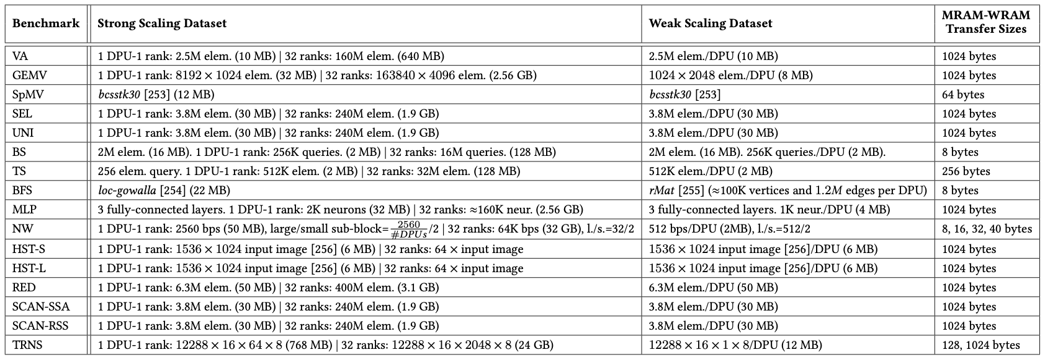
Datasets
Strong and weak scaling experiments
The PrIM benchmarks repository includes
all datasets and scripts used in our evaluation
https://github.com/CMU-SAFARI/prim-benchmarks

Slide 77
Strong Scaling: 1 DPU (I)
Strong scaling experiments on 1 DPU
We set the number of tasklets to 1, 2, 4, 8, and 16
We show the breakdown of execution time:
DPU: Execution time on the DPU
Inter-DPU: Time for inter-DPU communication via the host CPU
CPU-DPU: Time for CPU to DPU transfer of input data
DPU-CPU: Time for DPU to CPU transfer of final results
Speedup over 1 tasklet

Slide 78
Strong Scaling: 1 DPU (II)
VA, GEMV, SpMV, SEL, UNI, TS, MLP, NW, HST-S, RED, SCAN-SSA (Scan kernel), SCAN-RSS (both kernels), and TRNS (Step 2 kernel), the best performing number of tasklets is 16
Speedups 1.5-2.0x as we double the number of tasklets from 1 to 8.
Speedups 1.2-1.5x from 8 to 16, since the pipeline throughput saturates at 11 tasklets
KEY OBSERVATION 10
A number of tasklets greater than 11 is a good choice for most real-world workloads we tested (16 kernels out of 19 kernels from 16 benchmarks), as it fully utilizes the DPU’s pipeline.

Slide 79
Strong Scaling: 1 DPU (III)
VA, GEMV, SpMV, BS, TS, MLP, HST-S do not use intra-DPU synchronization primitives
In SEL, UNI, NW, RED, SCAN-SSA (Scan kernel), SCAN-RSS (both kernels), synchronization is lightweight
BFS, HST-L, TRNS (Step 3) use mutexes, which cause contention when accessing shared data structures

Slide 80
Strong Scaling: 1 DPU (IV)
VA, GEMV, SpMV, BS, TS, MLP, HST-S do not use synchronization primitives
In SEL, UNI, NW, RED, SCAN-SSA (Scan kernel), SCAN-RSS (both kernels), synchronization is lightweight
BFS, HST-L, TRNS (Step 3) use mutexes, which cause contention when accessing shared data structures
KEY OBSERVATION 11
Intensive use of intra-DPU synchronization across tasklets (e.g., mutexes, barriers, handshakes) may limit scalability, sometimes causing the best performing number of tasklets to be lower than 11.

Slide 81
Strong Scaling: 1 DPU (V)
SCAN-SSA (Add kernel) is not compute-intensive. Thus, performance saturates with less that 11 tasklets (recall STREAM ADD).
BS shows similar behavior
KEY OBSERVATION 12
Most real-world workloads are in the compute-bound region of the DPU (all kernels except SCAN-SSA (Add kernel) and BS), i.e., the pipeline latency dominates the MRAM access latency.

Slide 82
Strong Scaling: 1 DPU (VI)
The amount of time spent on CPU-DPU and DPU-CPU transfers is low compared to the time spent on DPU execution
TRNS performs step 1 of the matrix transposition via the CPU-DPU transfer.
Using small transfers (8 elements) does not exploit full CPU-DPU bandwidth
KEY OBSERVATION 13
Transferring large data chunks from/to the host CPU is preferred for input data and output results due to higher sustained CPU-DPU/DPU-CPU bandwidths.
https://arxiv.org/pdf/2105.03814.pdf
https://github.com/CMU-SAFARI/prim-benchmarks
Notes:
Fifth
TRNS

Slide 83
Strong Scaling: 1 Rank (I)
Strong scaling experiments on 1 rank
We set the number of tasklets to the best performing one
The number of DPUs is 1, 4, 16, 64
We show the breakdown of execution time:
DPU: Execution time on the DPU
Inter-DPU: Time for inter-DPU communication via the host CPU
CPU-DPU: Time for CPU to DPU transfer of input data
DPU-CPU: Time for DPU to CPU transfer of final results
Speedup over 1 DPU

Slide 84
Strong Scaling: 1 Rank (II)
VA, GEMV, SpMV, SEL, UNI, BS, TS, MLP, HST-S, HSTS-L, RED, SCAN-SSA (both kernel), SCAN-RSS (both kernels), and TRNS (both kernels) scale linearly with the number of DPUs
Scaling is sublinear for BFS and NW
BFS suffers load imbalance due to irregular graph topology
NW computes a diagonal of a 2D matrix in each iteration.
More DPUs does not mean more parallelization in shorter diagonals.

Slide 85
Strong Scaling: 1 Rank (III)
VA, GEMV, SpMV, BS, TS, TRNS do not need inter-DPU synchronization
SEL, UNI, HST-S, HST-L, RED, SCAN-SSA, SCAN-RSS need inter-DPU synchronization but 64 DPUs still obtain the best performance
BFS, MLP, NW require heavy inter-DPU synchronization, involving DPU-CPU and CPU-DPU transfers

Slide 86
Strong Scaling: 1 Rank (IV)
VA, GEMV, TS, MLP, HST-S, HST-L, RED, SCAN-SSA, SCAN-RSS, TRNS use parallel transfers.
CPU-DPU and DPU-CPU transfer times decrease as we increase the number of DPUs
BS, NW use parallel transfers but do not reduce transfer times:
BS transfers a complete array to all DPUs.
NW does not use all DPUs in all iterations
SpMV, SEL, UNI, BFS cannot use parallel transfers, as the transfer size per DPU is not fixed
PROGRAMMING RECOMMENDATION 5
Parallel CPU-DPU/DPU-CPU transfers inside a rank of DPUs are recommended for real-world workloads when all transferred buffers are of the same size.
https://arxiv.org/pdf/2105.03814.pdf
https://github.com/CMU-SAFARI/prim-benchmarks

Slide 87
Strong Scaling: 32 Ranks
Strong scaling experiments on 32 rank
We set the number of tasklets to the best performing one
The number of DPUs is 256, 512, 1024, 2048
We show the breakdown of execution time:
DPU: Execution time on the DPU
Inter-DPU: Time for inter-DPU communication via the host CPU
We do not show CPU-DPU/DPU-CPU transfer times
Speedup over 256 DPUs

Slide 88
Weak Scaling: 1 Rank
KEY OBSERVATION 17
Equally-sized problems assigned to different DPUs and little/no inter-DPU synchronization lead to linear weak scaling of the execution time spent on the DPUs (i.e., constant execution time when we increase the number of DPUs and the dataset size accordingly).
KEY OBSERVATION 18
Sustained bandwidth of parallel CPU-DPU/DPU-CPU transfers inside a rank of DPUs increases sublinearly with the number of DPUs.
https://arxiv.org/pdf/2105.03814.pdf
https://github.com/CMU-SAFARI/prim-benchmarks

Slide 89
CPU/GPU: Evaluation Methodology
Comparison of both UPMEM-based PIM systems to state-of-the-art CPU and GPU
Intel Xeon E3-1240 CPU
NVIDIA Titan V GPU
We use state-of-the-art CPU and GPU counterparts of PrIM benchmarks
https://github.com/CMU-SAFARI/prim-benchmarks
We use the largest dataset that we can fit in the GPU memory
We show overall execution time, including DPU kernel time and inter DPU communication

Slide 90
CPU/GPU: Performance Comparison (I)
The 2,556-DPU and the 640-DPU systems outperform the CPU for all benchmarks except SpMV, BFS, and NW
The 2,556-DPU and the 640-DPU are, respectively, 93.0x and 27.9x faster than the CPU for 13 of the PrIM benchmarks

Slide 91
CPU/GPU: Performance Comparison (II)
The 2,556-DPU outperforms the GPU
for 10 PrIM benchmarks with an average of 2.54x
The performance of the 640-DPU is within 65%
the performance of the GPU for the same 10 PrIM benchmarks

Slide 92
CPU/GPU: Performance Comparison (III)
KEY OBSERVATION 19
The UPMEM-based PIM system can outperform a state-of-the-art GPU on workloads with three key characteristics:
Streaming memory accesses
No or little inter-DPU synchronization
No or little use of integer multiplication, integer division, or floating point operations
These three key characteristics make a workload potentially suitable to the UPMEM PIM architecture.

Slide 93
CPU/GPU: Energy Comparison (I)
The 640-DPU system consumes on average 1.64x less energy than the CPU for all 16 PrIM benchmarks
For 12 benchmarks, the 640-DPU system provides energy savings
of 5.23x over the CPU

Slide 94
CPU/GPU: Energy Comparison (II)
KEY OBSERVATION 20
The UPMEM-based PIM system provides large energy savings over a state-of-the-art CPU due to higher performance (thus, lower static energy) and less data movement between memory and processors.
The UPMEM-based PIM system provides energy savings over a state-of-the-art CPU/GPU on workloads where it outperforms the CPU/GPU.
This is because the source of both performance improvement and energy savings is the same: the significant reduction in data movement between the memory and the processor cores, which the UPMEM-based PIM system can provide for PIM-suitable workloads.
https://arxiv.org/pdf/2105.03814.pdf
https://github.com/CMU-SAFARI/prim-benchmarks

Slide 95
Outline
Introduction
Accelerator Model
UPMEM-based PIM System Overview
UPMEM PIM Programming
Vector Addition
CPU-DPU Data Transfers
Inter-DPU Communication
CPU-DPU/DPU-CPU Transfer Bandwidth
DRAM Processing Unit
Arithmetic Throughput
WRAM and MRAM Bandwidth
PrIM Benchmarks
Roofline Model
Benchmark Diversity
Evaluation
Strong and Weak Scaling
Comparison to CPU and GPU
Key Takeaways

Slide 96
Key Takeaway 1
The throughput saturation point is as low as ¼ OP/B,
i.e., 1 integer addition per every 32-bit element fetched
Memory-bound region
Compute-bound region
KEY TAKEAWAY 1
The UPMEM PIM architecture is fundamentally compute bound.
As a result, the most suitable workloads are memory-bound.

Slide 97
Key Takeaway 2
KEY TAKEAWAY 2
The most well-suited workloads for the UPMEM PIM architecture use no arithmetic operations or use only simple operations (e.g., bitwise operations and integer addition/subtraction).

Slide 98
Key Takeaway 3
KEY TAKEAWAY 3
The most well-suited workloads for the UPMEM PIM architecture require little or no communication across DPUs (inter-DPU communication).

Slide 99
Key Takeaway 4
KEY TAKEAWAY 4
• UPMEM-based PIM systems outperform state-of-the-art CPUs in terms of performance and energy efficiency on most of PrIM benchmarks.
• UPMEM-based PIM systems outperform state-of-the-art GPUs on a majority of PrIM benchmarks, and the outlook is even more positive for future PIM systems.
• UPMEM-based PIM systems are more energy-efficient than state-of-the-art CPUs and GPUs on workloads that they provide performance improvements over the CPUs and the GPUs.

Slide 100
Executive Summary
Data movement between memory/storage units and compute units is a major contributor to execution time and energy consumption
Processing-in-Memory (PIM) is a paradigm that can tackle the data movement bottleneck
Though explored for +50 years, technology challenges prevented the successful materialization
UPMEM has designed and fabricated the first publicly-available real-world PIM architecture
DDR4 chips embedding in-order multithreaded DRAM Processing Units (DPUs)
Our work:
Introduction to UPMEM programming model and PIM architecture
Microbenchmark-based characterization of the DPU
Benchmarking and workload suitability study
Main contributions:
Comprehensive characterization and analysis of the first commercially-available PIM architecture
PrIM (Processing-In-Memory) benchmarks:
16 workloads that are memory-bound in conventional processor-centric systems
Strong and weak scaling characteristics
Comparison to state-of-the-art CPU and GPU
Takeaways:
Workload characteristics for PIM suitability
Programming recommendations
Suggestions and hints for hardware and architecture designers of future PIM systems
PrIM: (a) programming samples, (b) evaluation and comparison of current and future PIM systems

Slide 101
PrIM Repository
All microbenchmarks, benchmarks, and scripts
https://github.com/CMU-SAFARI/prim-benchmarks

Slide 102
Understanding a Modern Processing-in-Memory Architecture:
Benchmarking and Experimental Characterization
Juan Gómez Luna, Izzat El Hajj,
Ivan Fernandez, Christina Giannoula,
Geraldo F. Oliveira, Onur Mutlu
el1goluj@gmail.com
https://arxiv.org/pdf/2105.03814.pdf
https://github.com/CMU-SAFARI/prim-benchmarks

